Slide 1
Kirchhoff’s Voltage Law

Slide 2

By the end of this lesson, you should be able to:
Define Kirchhoff’s voltage law.
Calculate the voltage used by a particular component in a circuit using a combination of Kirchhoff’s voltage law and Ohm’s law.
Calculate the current or resistance of a particular component in a circuit using a combination of Kirchhoff’s voltage law and Ohm’s law.

Slide 3

Potential difference or voltage?
We have previously introduced the idea of potential difference, which is the change in potential energy per unit charge across two points in a circuit. The unit for electric potential is volts (V), which can also be referred to as the voltage.
In this lesson we will refer to this quantity as voltage, which is the more common name, but it will be referred to elsewhere as potential difference, so keep in mind that these two terms are used interchangeably.

Slide 4

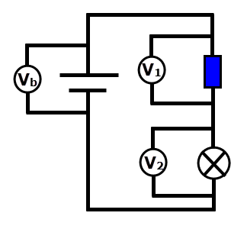

Kirchhoff’s voltage law states that all voltage supplied by a battery in a closed circuit loop will be used up.
This means that every component in a circuit uses a portion of the total voltage, such that there is 0 V returning to the battery. This happens regardless of how many components are in a circuit.
In general, Kirchhoff’s voltage law reads:
Where there could be many components, and V_{n}​ is the final component.
Alternatively, this could be written as:

Slide 5
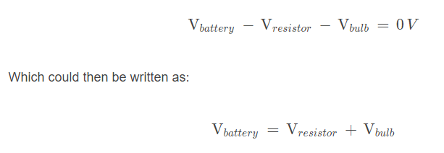
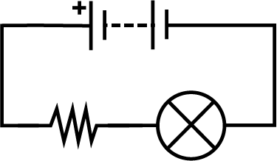
Now let’s see how this would look with an actual circuit.
In the circuits we will be studying, the battery represents the total voltage, and all other components will use up the voltage supplied by the battery. So, for the circuit below, with a battery, a bulb and a resistor, Kirchhoff’s voltage law will read:

Slide 6
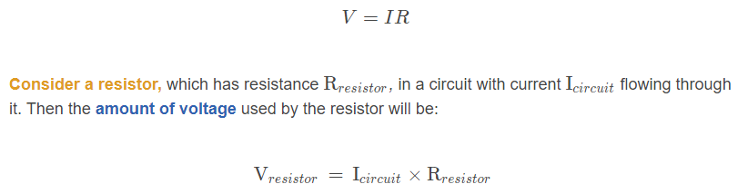
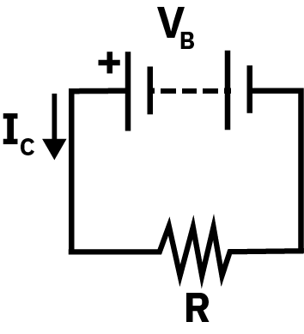
Each component will use a different amount of voltage.
How much voltage is used by a component depends on the amount of current running through a circuit and the resistance of an individual component. However, if two components are identical—for example two identical bulbs—then they will use the same amount of voltage.
The amount of voltage used by a component can be worked out using Ohm’s law:

Slide 7

We can also combine Ohm’s law with Kirchhoff’s voltage law.
We’ve already encountered Ohm’s law:
V=IR
And we can use this with Kirchhoff’s voltage law as well; it can tell us more about components in a circuit.
For example: If we have a circuit with a battery, a resistor and a bulb, we can re-write Kirchhoff’s voltage law from:

Slide 8
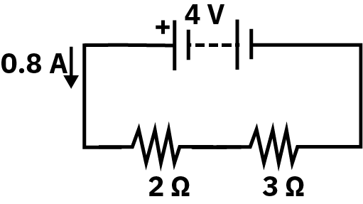
Now that we understand the theory, let’s put it into practice.
The circuit below has three components: a 4 V battery, a 2 Ω resistor and a 3 Ω resistor. There is a current running through the circuit of 0.8 A.
Calculate the voltage used by the resistors and show how this satisfies Kirchhoff’s voltage law.

Slide 9
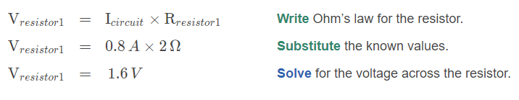
Solution: Part 1 of 3
Calculate the voltage used by the resistors and show how this satisfies Kirchhoff’s voltage law.
To begin, we need to find the voltages across each resistor using Ohm’s law:
V=IR
And substituting in the known values:

Slide 10
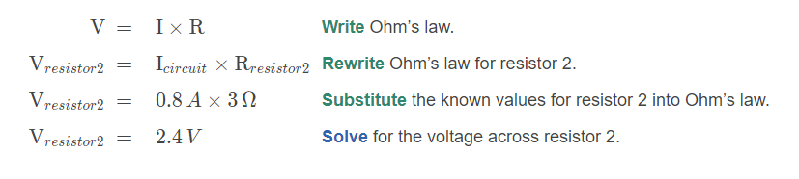
Solution: Part 2 of 3
Calculate the voltage used by the resistors and show how this satisfies Kirchhoff’s voltage law.
We know the voltage of the first resistor is 1.6V. Now let’s calculate the second resistor:

Slide 11
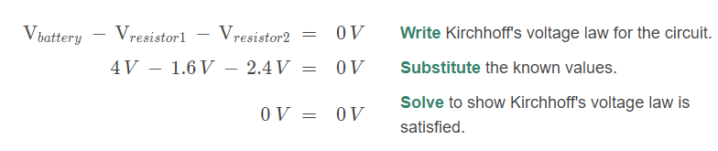
Solution: Part 3 of 3
Calculate the voltage used by the resistors and show how this satisfies Kirchhoff’s voltage law.
We have calculated the voltages of the two resistors to be 1.6V and 2.4V. Now let’s check this satisfies Kirchhoff's law:

Slide 12
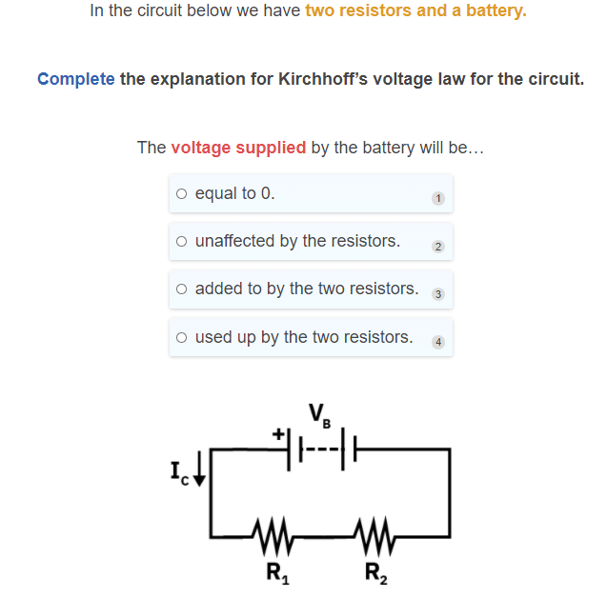

Slide 13
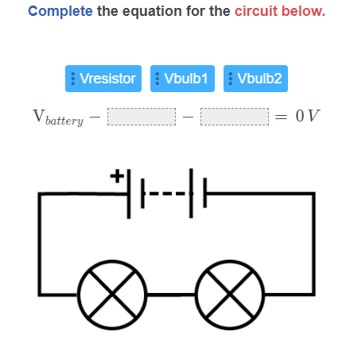

Slide 14
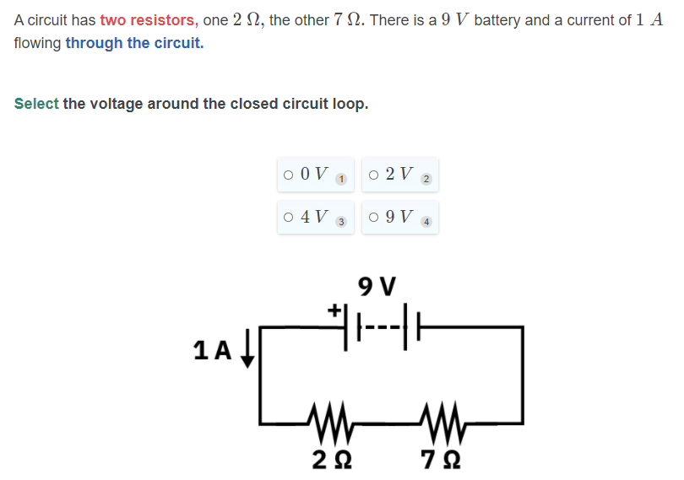

Slide 15
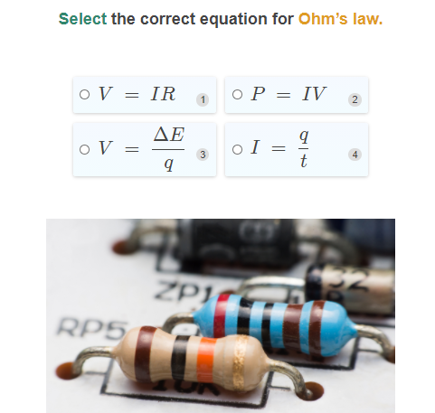

Slide 16
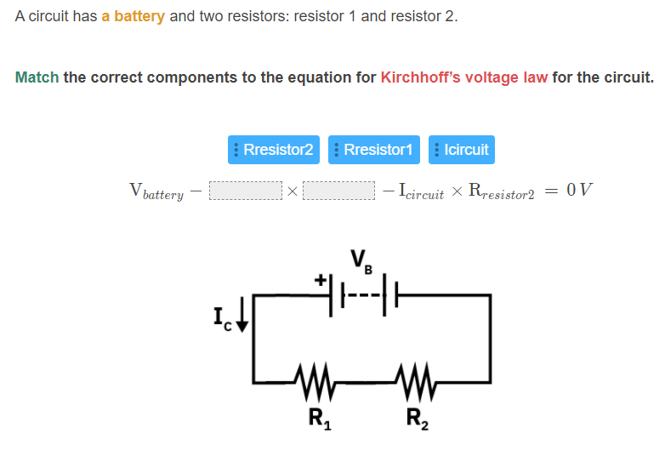

Slide 17
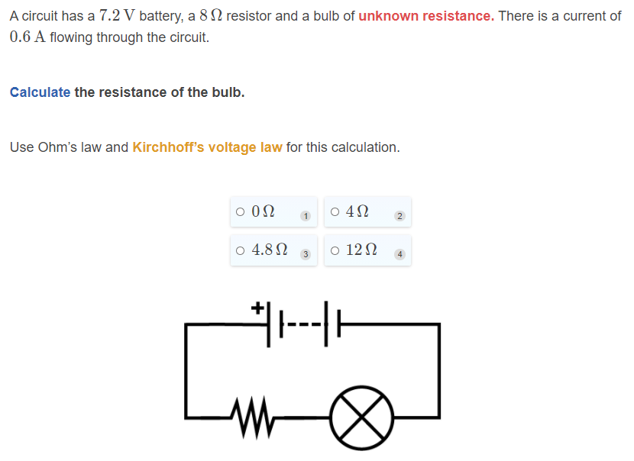

Slide 18
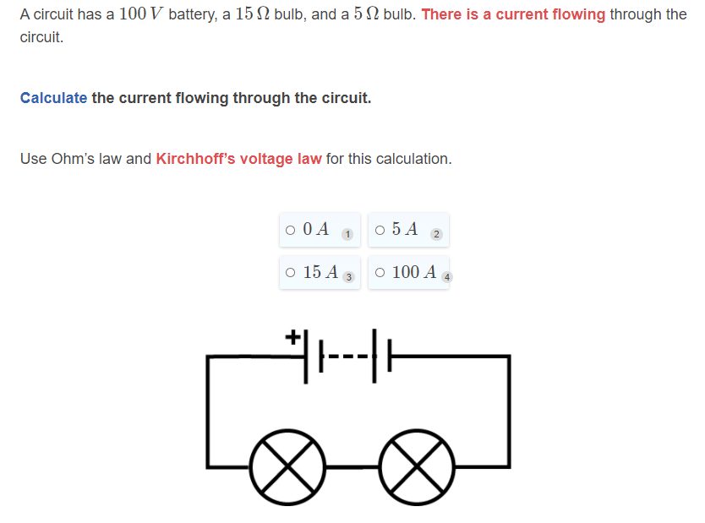

Slide 19
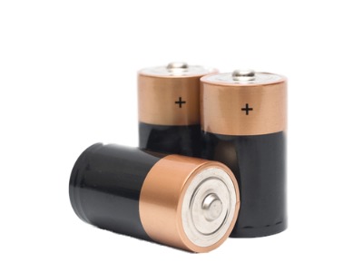
We have learned that the total voltage around a closed circuit is zero.
We can also say that the total voltage supplied is equal to the battery, so:
V_{total​}=V_{battery​}
Up till now, we have only had one battery in a circuit, so this hasn’t been necessary, but... what happens when we have a circuit with more than one battery?

Slide 20

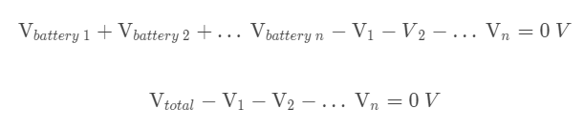
What happens when we have a circuit with more than one battery?
A circuit can have more than one battery. When they do, we simply add their voltages together. In a sense, they act as one larger battery.
Then Kirchhoff’s voltage law becomes:

Slide 21
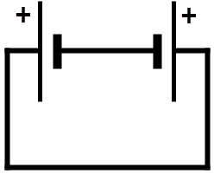
Batteries have a positive and a negative terminal.
These terminals tell us which way the current flows−with conventional current, it travels from the positive terminal to the negative terminal.
If we have more than one battery in a circuit, they can be placed in opposite directions, so current doesn’t flow through the circuit the same way we’ve seen before.
Current will always leave the positive terminal, and return to the negative terminal of the largest battery, so you can have current travelling in different directions in various sections of the circuit.

Slide 22

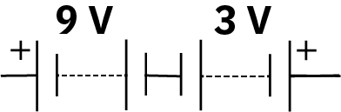
What happens if we wire two batteries in opposition to one another?
In this case the voltages produced by the batteries will oppose one another. This means the total voltage provided by the power source will be the difference between the two voltages.
The largest battery will dictate the direction the current travels, as it supplies the most voltage to the circuit.
In the image below, we have a 9V battery wired in opposition to a 3V battery. Therefore, the overall voltage becomes:

Slide 23
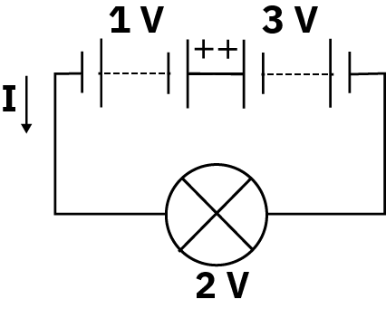
Let’s have a look at an example of a circuit with multiple batteries.
A circuit has a 1V battery, and a 3V battery, plus a bulb that has a potential difference of 2V across it.
Solve Kirchhoff’s voltage law for this circuit.

Slide 24
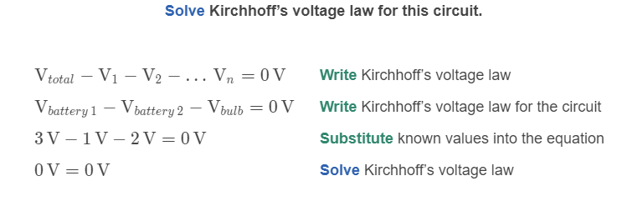
Solution
A circuit has a 1V battery, and a 3V battery, plus a bulb that has a potential difference of 2V across it.
The smaller battery opposes the larger one, so there is 2V of total voltage supplied by the batteries. The voltage is entirely used up by the bulb, satisfying Kirchhoff’s voltage law.

Slide 25
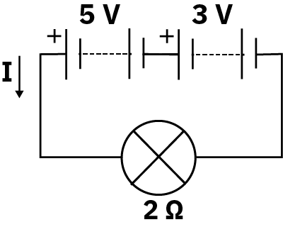
Let’s have a look at a different example.
A circuit has a 5V battery and a 3V battery, along with a 2Ω bulb.
Calculate the current flowing through the circuit.

Slide 26
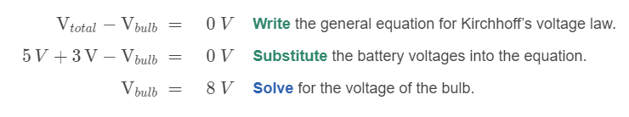
Solution: Part 1 of 2
A circuit has a 5V battery and a 3V battery, along with a 2Ω bulb.
Calculate the current flowing through the circuit.
Here the two batteries get added together, as they face in the same direction. We first calculate the voltage across the bulb.

Slide 27
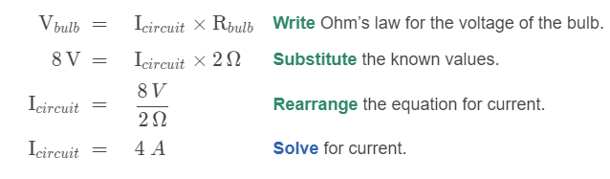
Solution: Part 2 of 2
A circuit has a 5V battery and a 3V battery, along with a 2Ω bulb.
Calculate the current flowing through the circuit.
On the previous slide we calculated that the total voltage provided to the bulb is 8V, now we solve for the current of the circuit.

Slide 28


What happens if we wire many batteries together, in multiple directions?
When we have many batteries, we group them by direction. Batteries facing in the same direction will get added together, and the group of batteries which supply the most voltage to the circuit will dominate.
In the image below, we have a 9V and a 4V battery wired in opposition to a 3V and a 1V battery. Therefore, the we add these separately:
9V+4V=13V
and:
3V+1V=4V
The group of batteries supplying 13V will then dominate the batteries that are opposing them, as the supply a greater voltage. Then the total voltage will be:

Slide 29
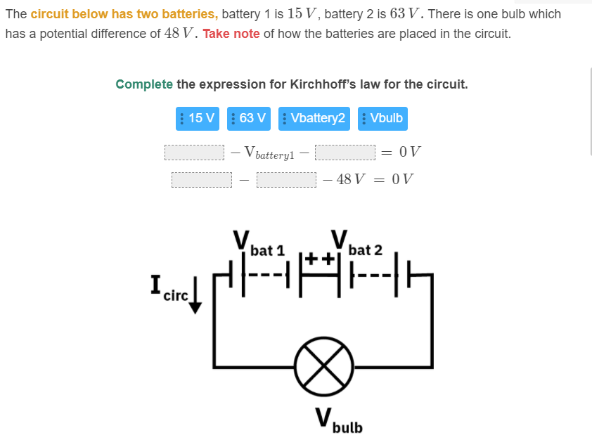

Slide 30
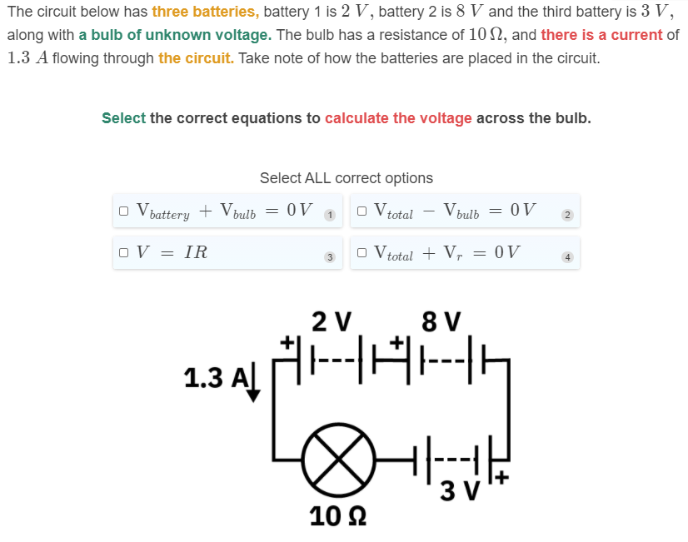

Slide 31
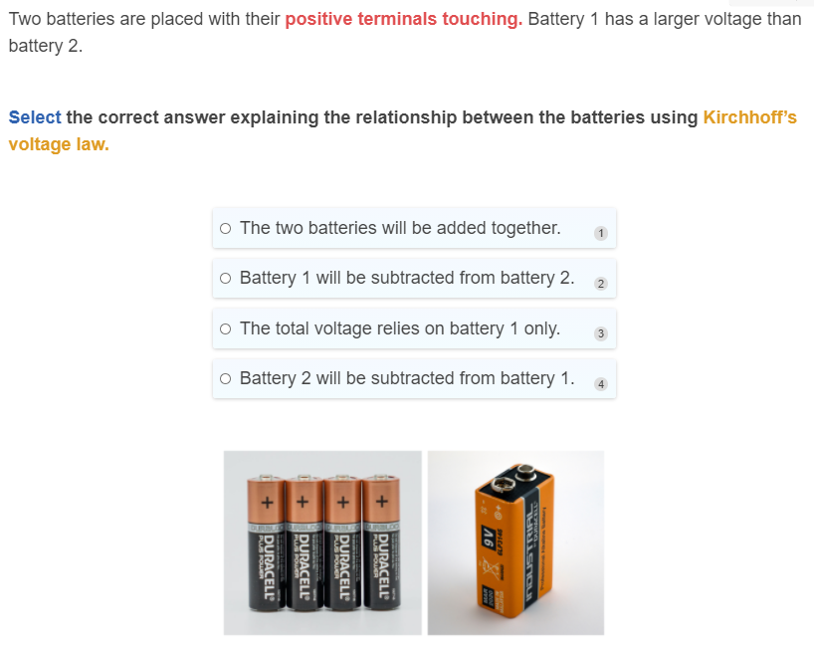

Slide 32
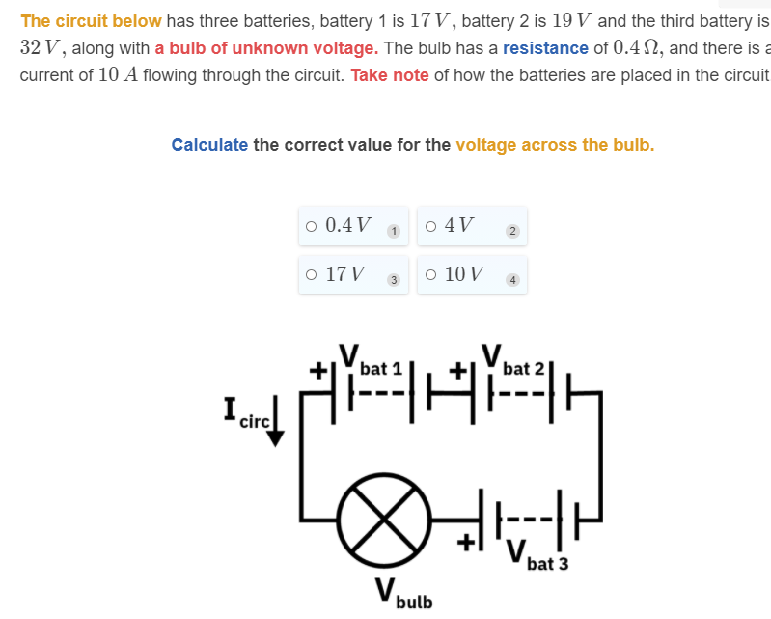

Slide 33
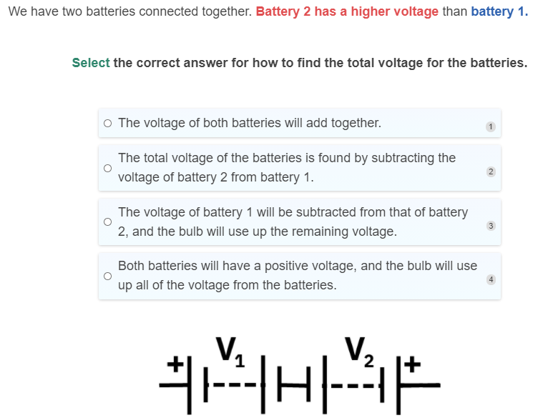

Slide 34
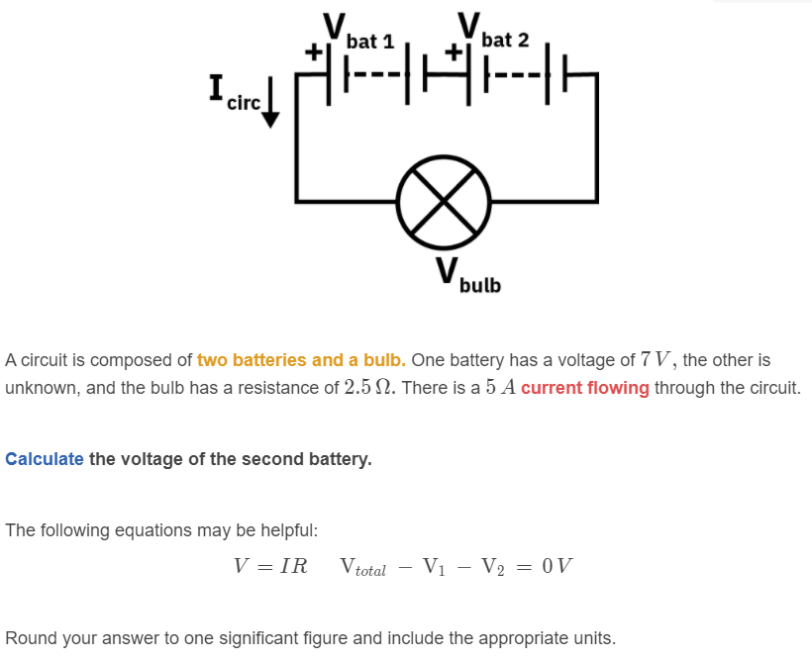

Slide 35
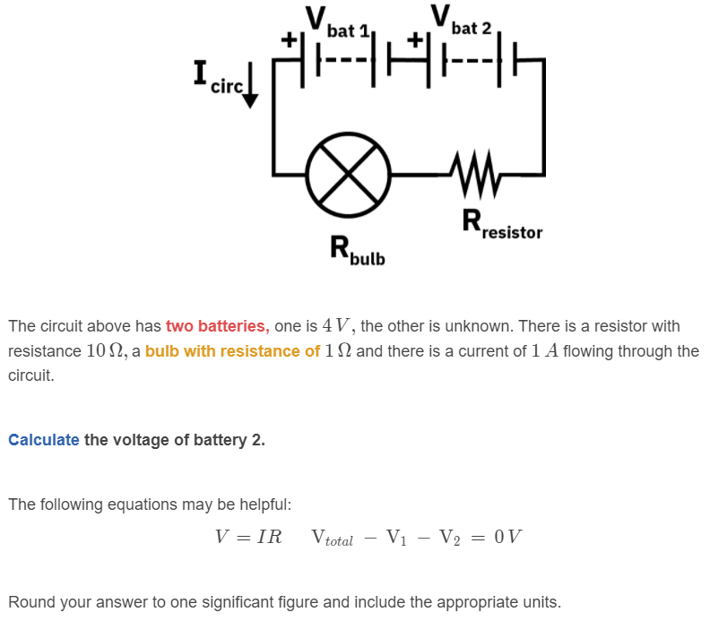

Slide 36
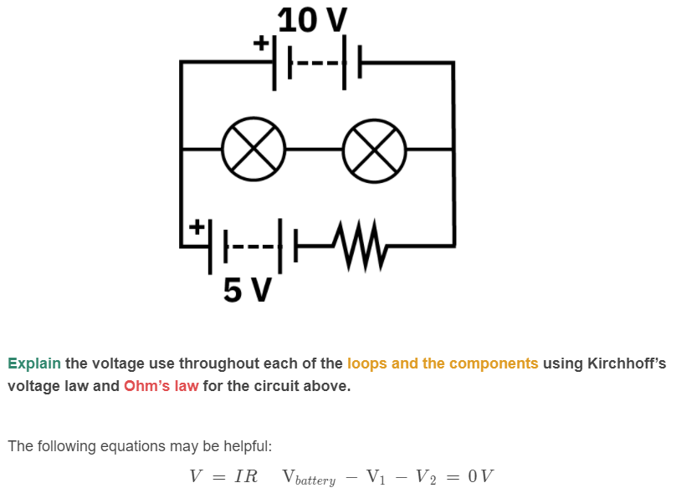

Slide 37
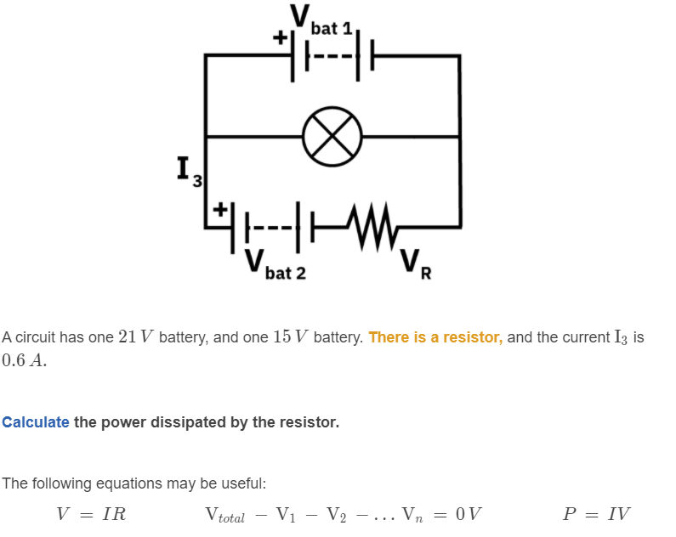

Slide 38
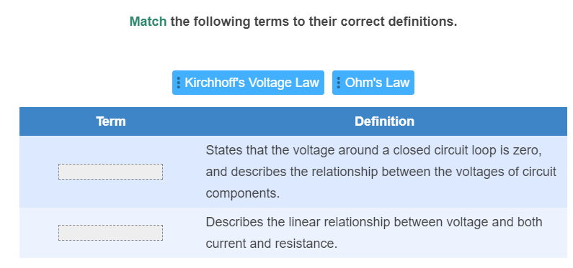

Slide 39
